Slide 1


Class Naming Convention in CSS

Slide 2

Topics
Introduction to a class naming convention
Importance of consistent and meaningful class names
Popular naming conventions like BEM

Slide 3
Introduction to a class naming convention
In CSS, A class naming convention in CSS is a set of guidelines used to create consistent and meaningful names for CSS classes applied to HTML elements.
The Primary goals - enhance the organization, Maintainability, Readability of CSS code especially in large project with multiple developers

Slide 4
Importance of Consistent and meaningful class names
The importance of of consistent and meaningful class naming conventions includes the following points -
Understanding and Readability
Maintainability and Refactoring
Code Reusability
Collaboration and Teamwork
Semantic Clarity
Self-Explanatory Code and Documentation
Avoid Naming Conflicts
Professionalism and Code Quality

Slide 5
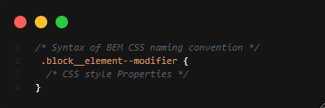
Popular naming conventions like BEM
BEM stands for Block, Element and Modifier

Slide 6

THANK YOU

